Slide 1
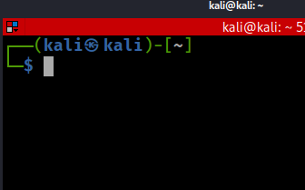
Linux Command Line Tutorial

Slide 2
Overview
Virtual file system
File structure
Path and path variable
Create folders and files
File copy & deletion
Search for information
Networks
Create a batch file
Update/install software

Slide 3
Virtual file system (VFS)

Slide 4
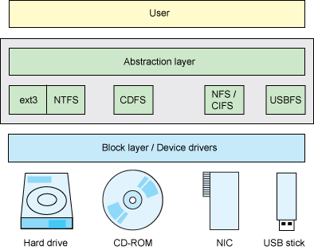
Linux is a VFS
VFS allows client applications to access different types of concrete file systems in a uniform way
provides an abstract layer for upper-layer applications
Each and everything in Linux is a file (Everything appears somewhere in the filesystem)
file, directory, Hard disks, CD/DVD, NIC, USB
Devices can be represented as file-like object under /dev/ filesystem.
OS recognizes files by
inode (index node)
https://developer.ibm.com/technologies/linux/tutorials/l-virtual-filesystem-switch/
Notes:
The "Everything is a file" phrase defines the architecture of the operating system. It means that everything in the system from processes, files, directories, sockets, pipes, ... is represented by a file descriptor abstracted over the virtual filesystem layer in the kernel
Devices can be represented as file-like object under /dev/ filesystem.
Unix has no direct equivalent of the Windows registry. The same information is scattered through the filesystem, largely in /etc, /proc and /sys.

Slide 5
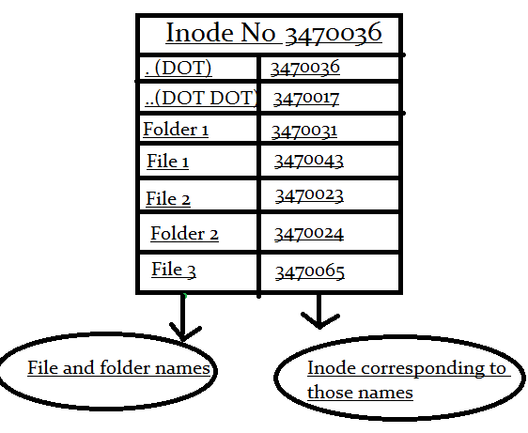
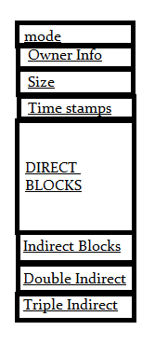
What is inode?
inode is an ID of a file
unique number
inode is a data structure of a file
You store your information in a file, and the operating system stores the information/metadata about a file in an inode
inode points to the content of a file
How to access to a file?
inode ID
file name=>inode ID
permission information
block pointers
https://www.slashroot.in/inode-and-its-structure-linux

Slide 6
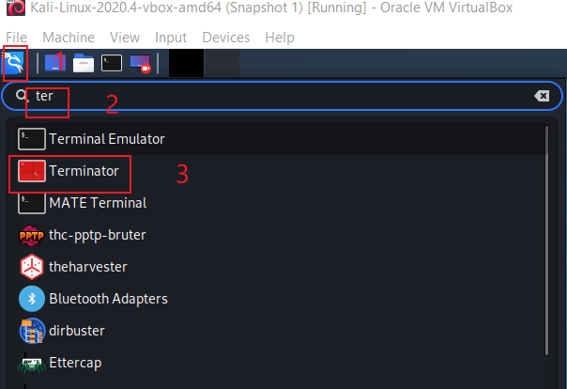
Open a Linux Terminator

Slide 7
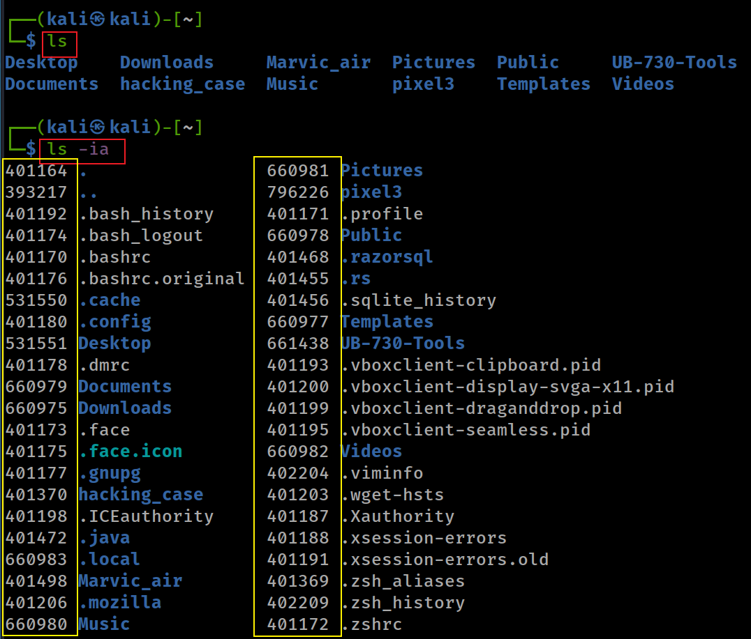
File inode
-i, --inode print the index number of each file
-a, --all do not ignore entries starting with . (hidden file)

Slide 8
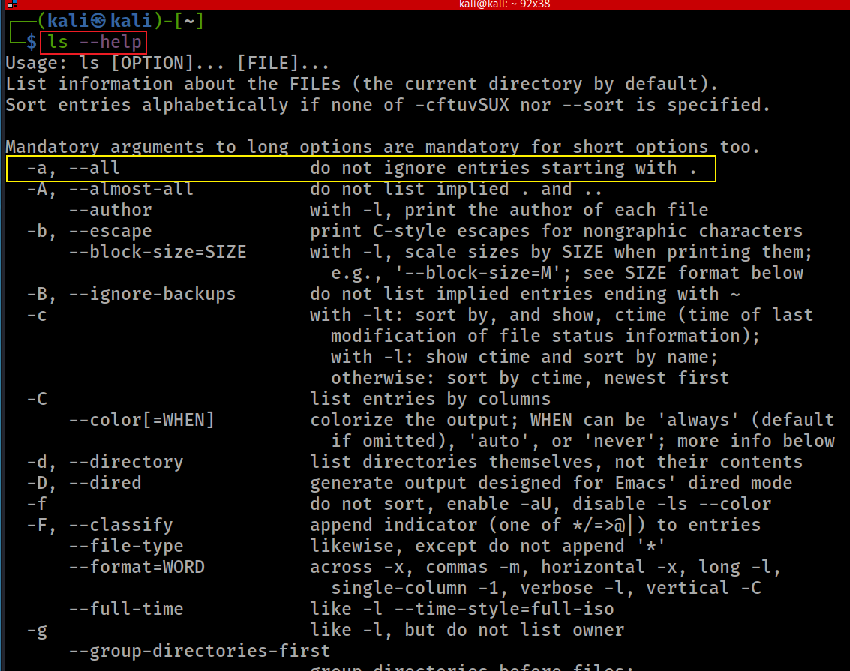

Slide 9
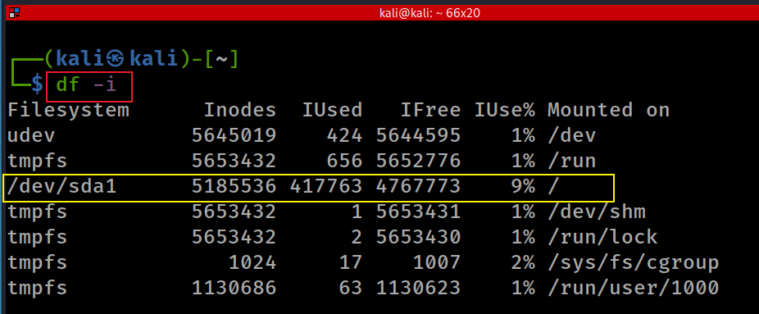
Disk free information (df) inode
-i, --inodes list inode information

Slide 10
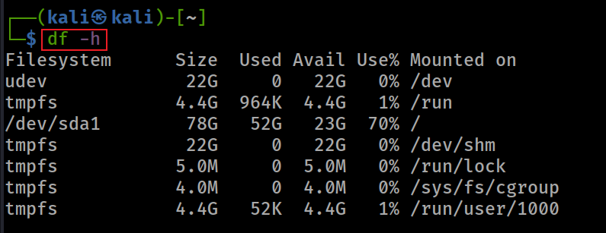
Show human readable format

Slide 11
File Structure

Slide 12
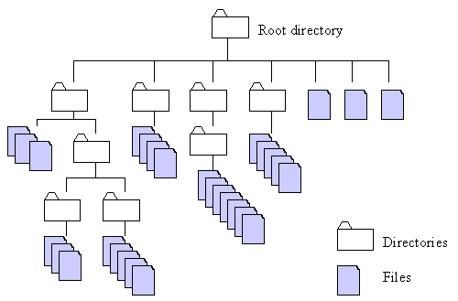
http://home.easy-key.info/images/stories/file_structure.gif

Slide 13
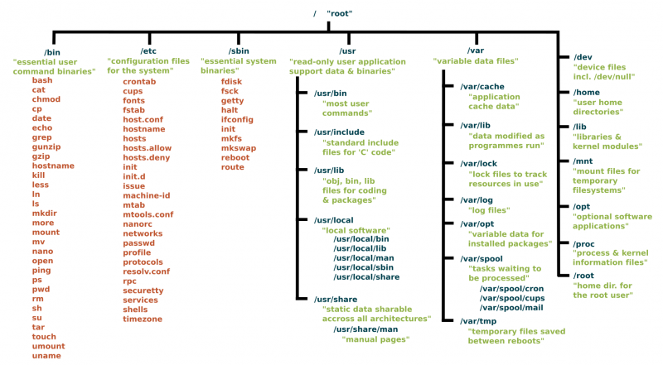
Unix has no direct equivalent of the Windows registry. The same information is scattered through the filesystem, largely in /etc, /proc and /sys.
https://www.linux.com/sites/lcom/files/styles/rendered_file/public/standard-unix-filesystem-hierarchy.png?itok=CVqmyk6P

Slide 14
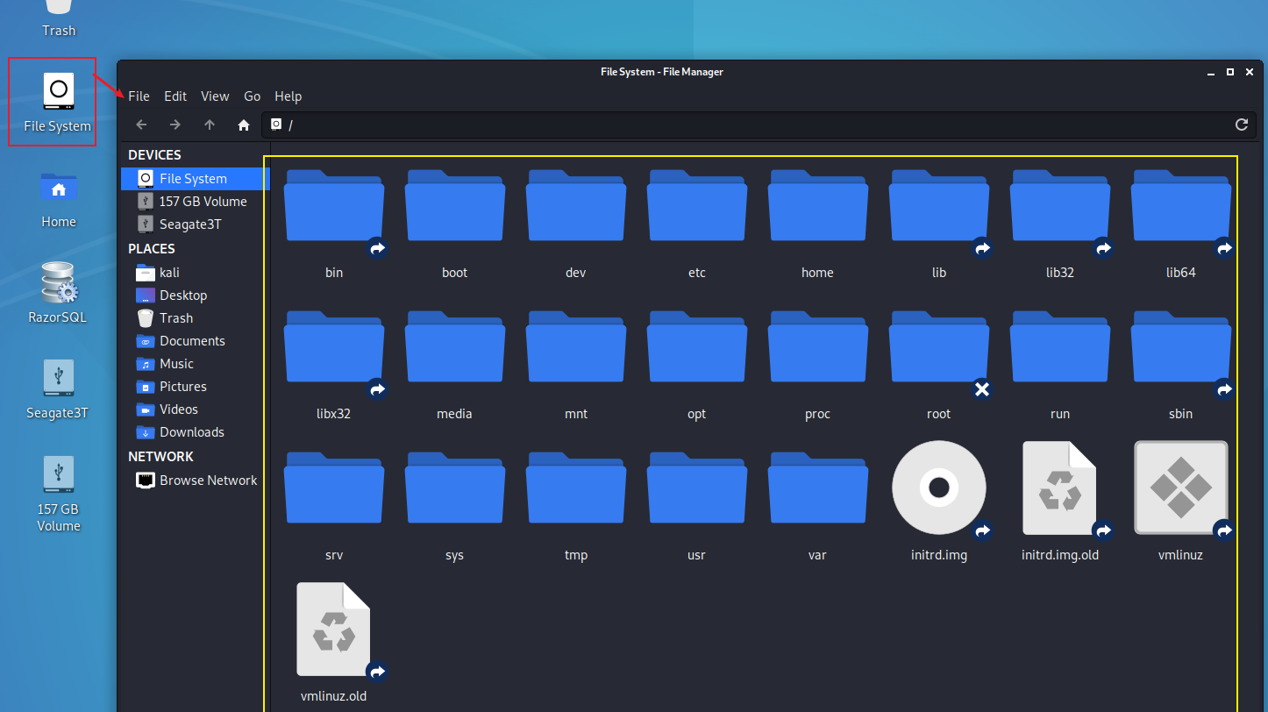

Slide 15
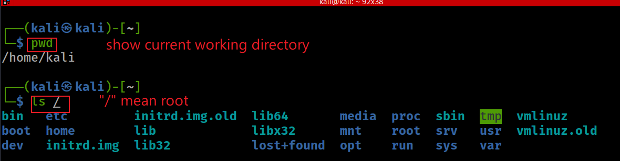
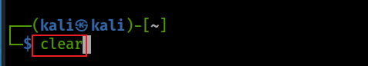
Show Linux file system from root /
Check where you are (impact all the commands you entered)
Clear screen

Slide 16
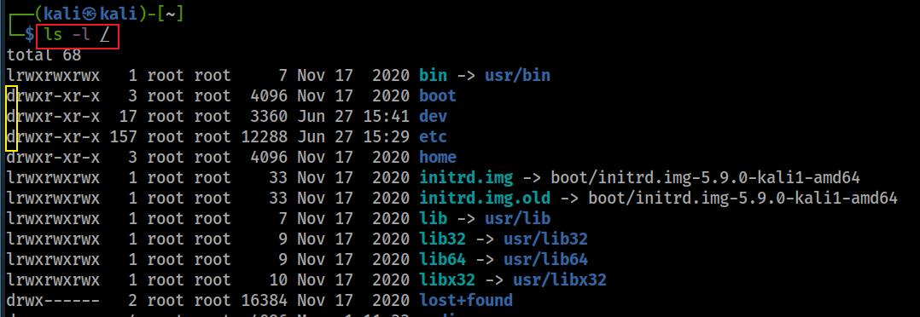
Show details of file/directory

Slide 17
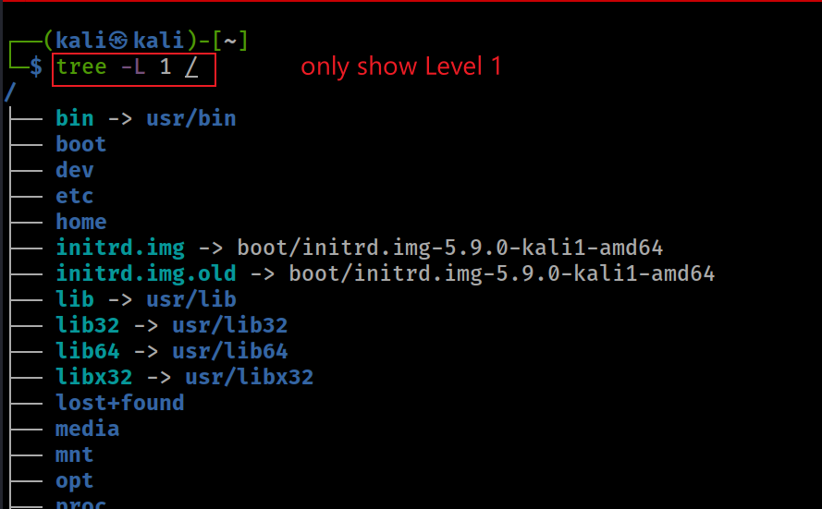
Show Linux file system from root with tree
Remember use following command for help
tree --help

Slide 18
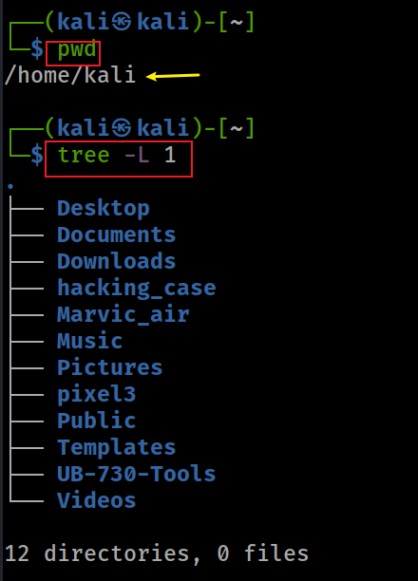
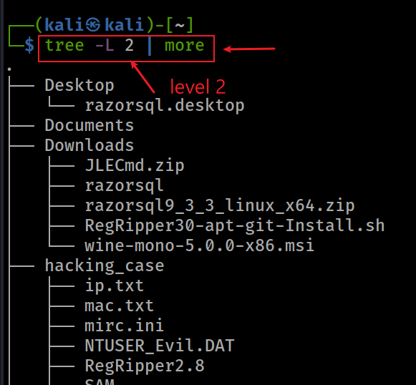
Show current working directory (pwd) with tree

Slide 19
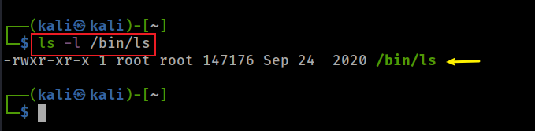
Display ls command under /bin
Why can ls be executed in any folder?

Slide 20
Path and Path variable

Slide 21
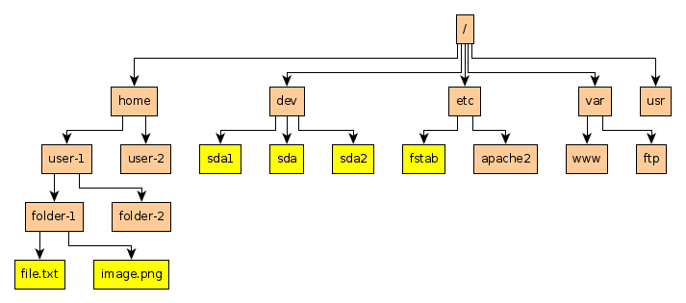
Example of paths
Absolute path to file.txt: /home/user-1/folder-1/file.txt
Relative path to file.txt (Under folder-2): ../folder-1/file.txt

Slide 22
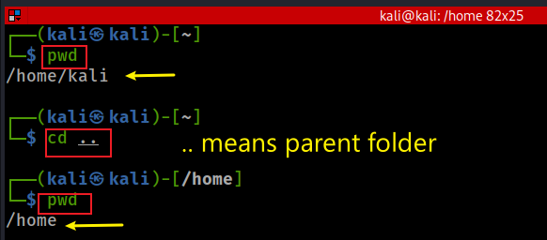
Change to parent path using relative path

Slide 23
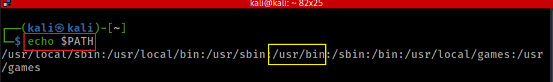
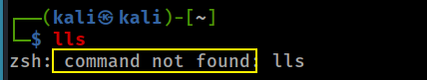
Path variable
How does OS execute a command?
search command in current directory
if can’t find it, search for command in each path defined in path variable
if can’t find it, OS throws command not found error message

Slide 24
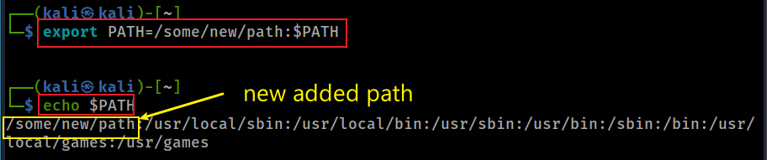
Adding a new path
Notes:
export PATH=/some/new/path:$PATH

Slide 25
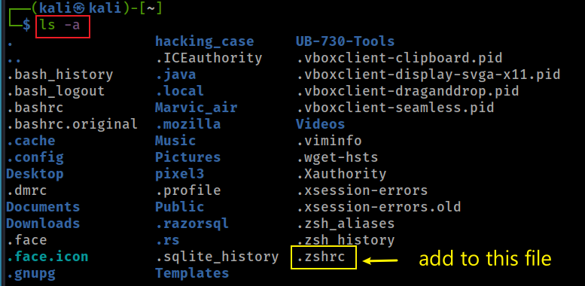
Persisting the new path
we discuss the details later

Slide 26
Create folders and files

Slide 27

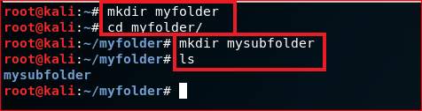
Create folders
home
\myfolder
\mysubfolder

Slide 28
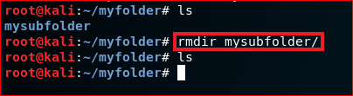
Delete folders

Slide 29
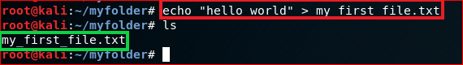
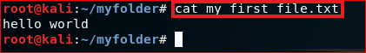
Create a new text file
\user home
\myfolder
Show the content of the file
hello world
my_first_file.txt

Slide 30
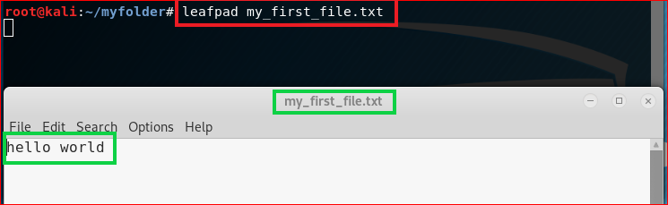
Show the content of the file

Slide 31
File Copy & Deletion

Slide 32
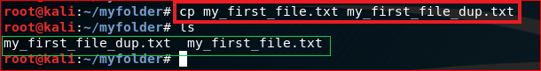
Copy (cp) a file

Slide 33
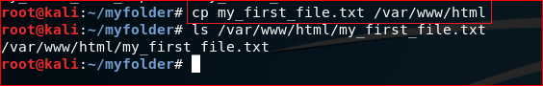
Copy (cp) a file to a different location

Slide 34
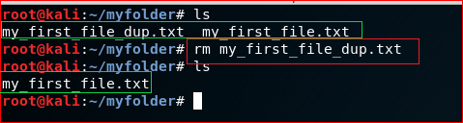
Remove a file: rm

Slide 35
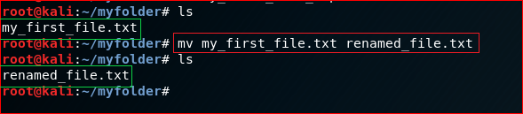
Rename a file (mv)

Slide 36
Search for information

Slide 37
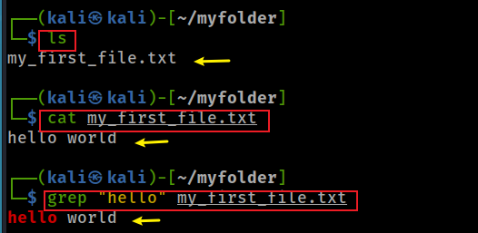
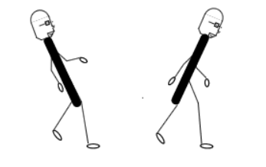
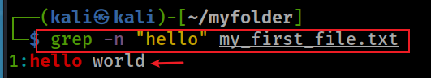
Search for a string in a text file
grep search
backslash/Wins
forward slash/Linux
Show line number while displaying the output
Notes:
cat my_first_file.txt
grep "hello" my_first_file.txt
https://sites.cs.ucsb.edu/~pconrad/topics/BackslashVsForwardSlash/

Slide 38
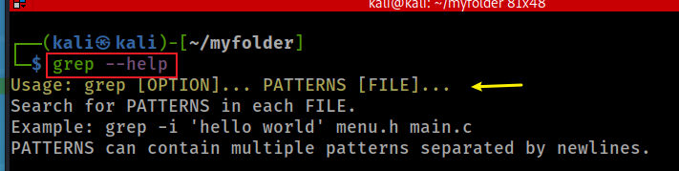
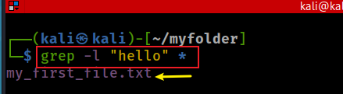
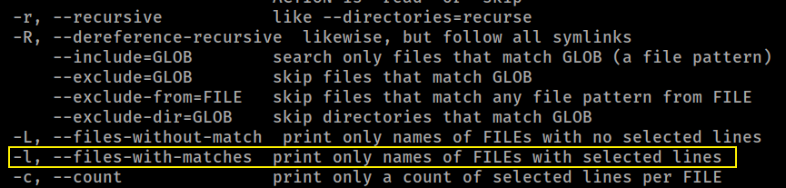
Search for file names that that contains the given string/pattern
grep help
Search for file contains “hello”

Slide 39
Networking

Slide 40
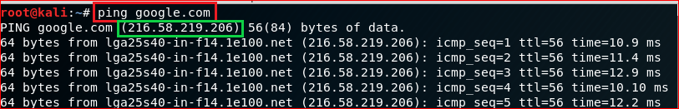
Test network connection using domain name

Slide 41
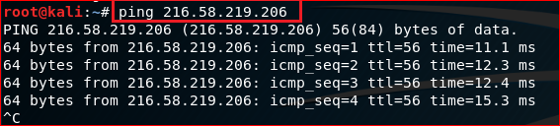
Test network connection using IP

Slide 42
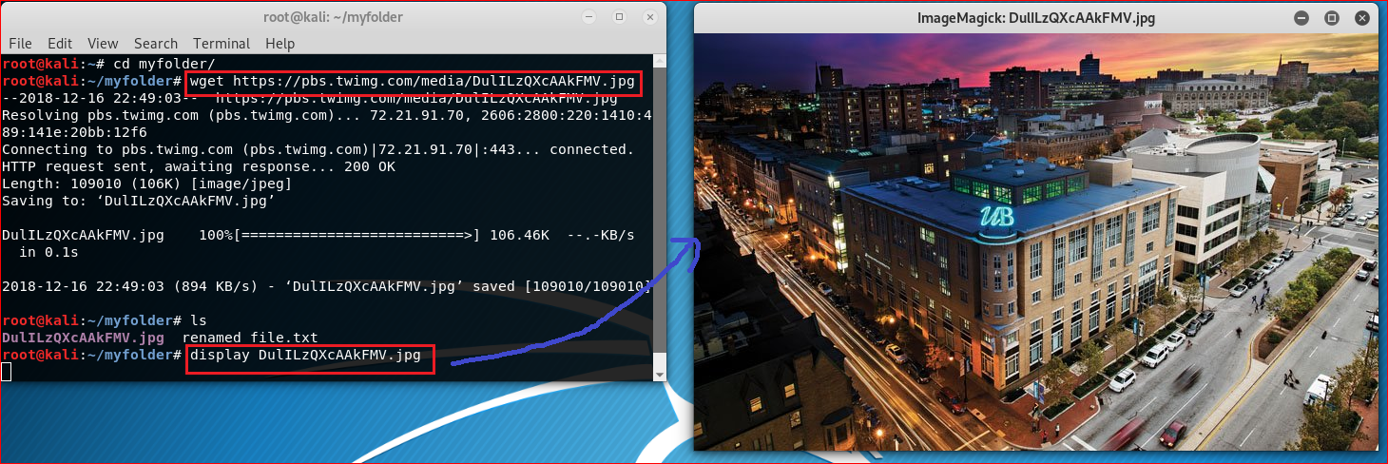
Download a file
https://pbs.twimg.com/media/DulILzQXcAAkFMV.jpg

Slide 43
Create a script file

Slide 44
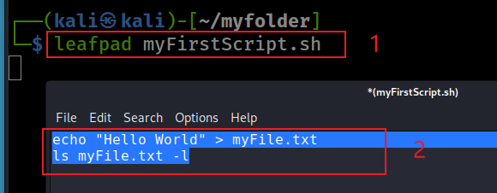
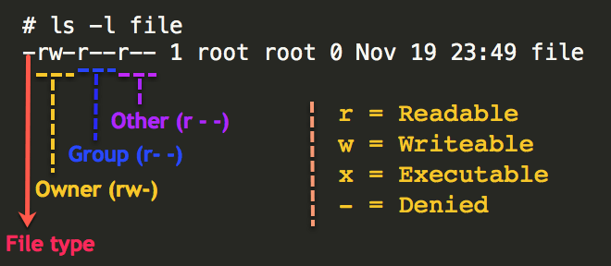
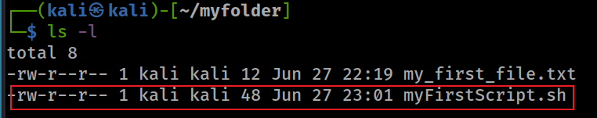
Create a simple script file
Create a script using leafpad
#!/bin/sh
remember
Check permission of files
Notes:
#!/bin/sh
echo "Hello World" > myFile.txt
ls myFile.txt -l

Slide 45
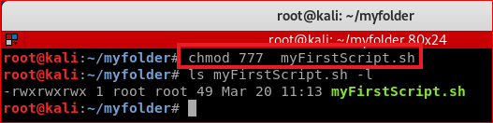
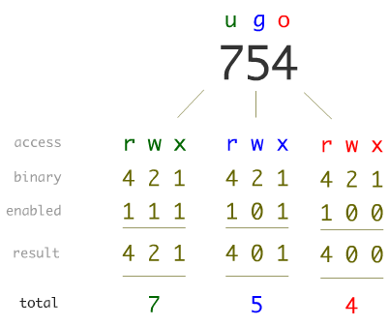
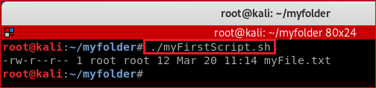
Linux Permissions

Slide 46
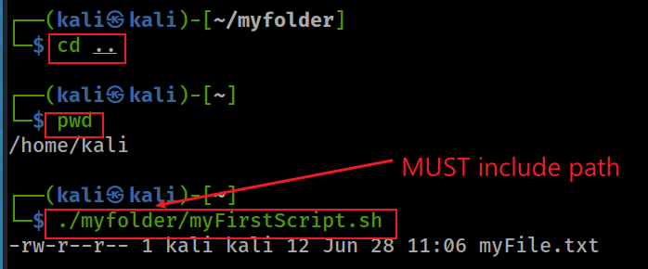
Execute script in a different folder

Slide 47

Add a path to the path variable
Notes:
export PATH=/home/kali/myfolder:$PATH

Slide 48
Update/Install software

Slide 49

Update software

Slide 50


Install terminator

Slide 51


Slide 52

Zip/unzip files

